Slide 1

Success Hub Digitalizing organization

Slide 2
Agenda
Customer scenarios and requirements
Microsoft’s recommendation on ALM (prescriptive)
How is Microsoft internally implementing SuccessHub? (Actual implementation)
ALM
Shared development model

Slide 3
How is MSFT implementing the co-development model? Success Hub

Slide 4


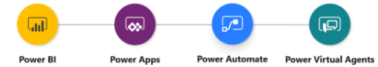
Microsoft & BAG
Microsoft
Microsoft IT (CSEO)
CoE- admin, governance, etc.
…
Azure
Business Application Group (BAG)
Office 365
…
Success Hub
Digitalizing the group

Slide 5
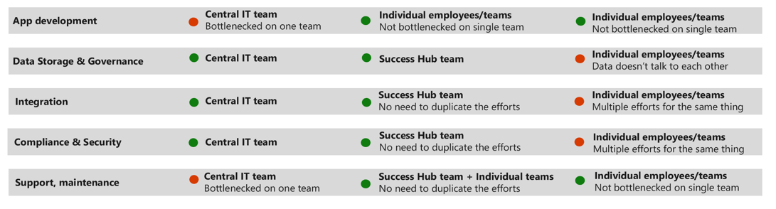
Why was Success Hub created?
BAG
Microsoft
Central IT Team (CSEO)
(Center of Excellence)
Individual Employees

Slide 6
Why was Success Hub created?
Microsoft
BAG
Central IT Team
(Center of Excellence)
Success Hub
Individual Employees

Slide 7



Digital feedback loop
1
a
3
Engage
customers
c
o
Empower
people
e
h
2
r
s
f
v
Data & Intelligence
g
k
i
t
u
l
4
x
j
w
Optimize
operations
n
y
Transform
products
m
bb
aa
cc
dd

Slide 8

Digitally transforming BAG
Support customers
ACE, Case review app
Capture feedback
Pulse, Ideas, One feedback*
a
1
3
Engage with customers
FT Implementation apps
Customer & Exec Eng
c
o
Customer health
Bedrock portal
e
p
f
h
2
r
s
v
Success Hub
AI + Machine Learning
g
k
i
t
u
Publish plans
Release planner
Manage operations
Request Manager*
l
j
w
4
x
n
m
aa
y
bb
Employee requests
Flexibility@Work*
cc
dd
Product planning
BAG Roadmap
Skill development
FT Skill Management app
Trainings app, vNext*
Integrations
MSX
OCP
ICM
Customer Service
AAD
ADO
LCS
GitHub
* In Progress

Slide 9
Shared development Model
Sub-divided the team into workstreams based on the business scenarios
Governance process applied for any new non-trivial work
Small scope feature bypass
Governance focus on Shared Entities & attributes
Scope Alignment
Review high level user experience & schema changes
1
Update ADO
Add feature with scope & schema changes
2
Partner approval
Approval mail to impacted stakeholders
3
Workstream leads PR sign-off
Dev & PM, code quality, scope alignment, experience quality…
5
Governance Automation
Schema changes, small scope, permission warning, duplicate components…
4
Enables shared development at SCALE

Slide 10
Success Hub App onboarding support
Getting started
Process overview
Org & user provisioning
Office hours
Planning
Backlog guidelines
Scope, experience, & schema reviews
Data governance
Dev & test
Dev guidelines
Design Reviews
Code Reviews
Test deployments
Go-live
Production deployments
Post go-live
Incident triage
Debug assistance
Compliance
Maintenance
Privacy
Success Hub Team
Success Hub leads PM lead Platform team | PM lead Dev lead Platform team | Dev lead PM lead Platform team | Deployment lead Support team | Support team Dev lead Platform team
App Team
Backlog workitems
Feature reviews
App-specific compliance reviews
Component development
Test cases
Automated tests
PR creation
Code reviews
Manual test case execution and signoff
User access
App admin
ICM team
Issue debugging & resolution
28 hours + 4 hours/elapsed project week
https://aka.ms/successhubdev

Slide 11
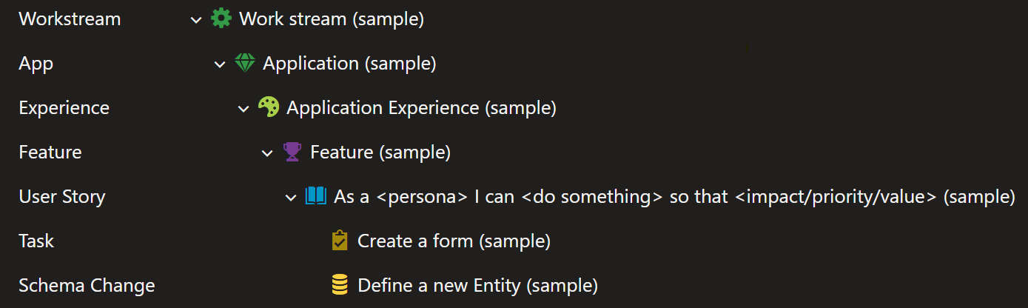
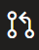
ADO structure
<business area>
My business area hub
Business area hub admin
Only used for very large apps
Business area hub admin v1
Scope, data governance, & experience review
Design review
Pull Request
Add a form and an attribute
Deployment review

Slide 12
Governance/ALM/Test
Workitems
ADO structure
Pull Requests
Test results
Scope alignment
Test
Production Support
Test requirements
Schema changes
Connection References
Signoffs
Small Scope features
Hot fixes
CEN Sev2 automation
DVTs
JIT Access
Impact
LT signoff
CEN Sev3 test scripts
Reviews
App team Signoffs
Workitem checks
Dev & PM signoff
Security roles
App ICM Teams
Sev2 RCAs
Bugs in current sprint

Slide 13
Weekly schedule
 | Monday | Tuesday | Wednesday | Thursday | Friday
9:00 am IST | Production Deployment
8:00 am PST |  | Feature Review | Deployment Readiness Review
9:30 am PST |  |  | Office Hours (bi-weekly)
12:00 pm PST |  |  | Deploy to Test
3:00 pm PST |  |  |  |  | Test signoff due

Slide 14
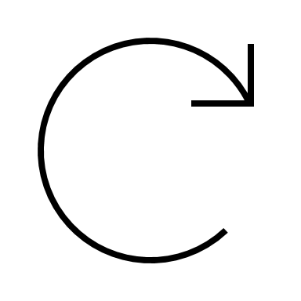


ALM & Deployment
weekly
POC
Workstream 1
Dev (1)
as needed
UAT
Workstream 2
Dev (1)
weekly
weekly
Test (1)
Automated tests
PROD
Workstream n
Dev (1)
All deployments are using Azure Devops/Power Platform build tasks

Slide 15
ALM – PG links
PowerApps ALM Documentation
https://docs.microsoft.com/en-us/power-platform/alm/
CI/CD Tooling
Azure DevOps: https://docs.microsoft.com/en-us/power-platform/alm/devops-build-tools
GitHub: https://docs.microsoft.com/en-us/power-platform/alm/devops-github-actions
COE Starter Kit (including ALM)
https://docs.microsoft.com/en-us/power-platform/guidance/coe/starter-kit-explained

Slide 16


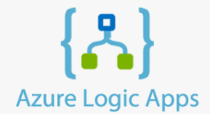


Integration
Apps (40+ apps; 20+ teams)
Model driven Canvas Portal Automate Dashboard
Success Hub Platform
Shared Data Support Maintenance Compliance & Security
Integrations
MSFT Sales
LCS
Azure DevOps
Partner Data
Data Hub
Virtual Entity
ICM/SR
Finance
Partner Contacts
Virtual Entity
Azure Data Factory

Slide 17
Security, Compliance & Integration
Integration – once done can be leveraged by any app developing
High Volume of Read Only data -> Virtual entities
High Volume of RW data -> Logic Apps
Simple integration -> flows
Specific roles are created to honor security
Regular compliance reviews at Success Hub level
Success Hub as well stores confidential information
App team doesn’t need to do compliance reviews if they are using existing data entities and integrations

Slide 18
Support & Maintenance
Support channels to triage issues
Wiki/Guidance & Weekly Office hours to ask questions
Maintenance (platform alerting and monitoring) done by single team (Platform workstream).
Telemetry Dashboard to track performance and health metrics
Centralized; yet de-centralized

Slide 19
Learnings & Guidance
Decentralize with workstream for scalable co-development model
Automated tests help detect lot of breaking changes on shared entities
Unexpected data changes (Taxonomy) in shared entities are difficult to test
Be the first one to champion new features
Anything wrong with the apps create bad perception of the platform as well e.g. performance, etc.

Slide 20
Need your inputs
What would you like to learn from us more?
ALM?
Co-development?
Governance?
Apps?
Anything else?

Slide 21
Customer & Partner
Focused on enabling customers & partners successful for Dynamics 365 & Power Platform
Discover
Implement
Production
Customer engagements
Steps
Pre-sales
ISV leads
Partner lead implementation
MS lead implementation
ISV scenarios
Success Hub
Apps / work
ISV leads
Customer engagement
Helix & FRP
Partner Architect
Power CAT
Exec engagement
Customer engagement
Pulse, ACE
Customer 360

Slide 22
ProductOps (Product lifecycle)
Focused on overall product lifecycle and investments focused for stitching the end to end scenario
Product planning
Product feedback/ improvement
Product deprecation
Product availability
Steps
Scoping & Prioritization
Resourcing & budgeting
Development
Customer comms
Get feedback from various sources
Deprecation approval from LT
Customer comms
Success Hub
Apps / work
Product planning app
Roadmap
Release planner & release notes
Supportability checklist
Geo availability
Roadmap
OneFeedback app
Deprecation process
Release notes
Integration with MSFT product lifecycle page

Slide 23
DevOps
New workstream is focused on Engineer, Support and SRE persona. It will enable us to get more people from BAG & CSS to use Success Hub/Power Platform
Develop
Deploy
Support
View & root cause customer reported issues
Transfer issues to the right team
Steps
Get a dev environment
Code (VS/Azure)
Test (VS/Azure)
Deploy (SDP)
Success Hub
Apps / work
Case review; IPD Attribution; ICM Tracking

Slide 24
BizOps
Workstream focusing on optimizing operations, reviews and processes, and as well empowering people.
Reviews
Events & Trainings
Operations
Success Hub
Apps / work
Bedrock Portal
Customer Health Portal
Training app
CAB
Schedule Builder
Onboarding portal
Admin operations app
BAG Home
BAG Jobs

Slide 25


